Slide 1

SLAM Course
08 - Factor Graphs
Dr Alejandro Fontán Villacampa
April 2026

Slide 2
Course Material Attribution
These slides were created by Alejandro Fontan as part of the SLAM course.
I have made every effort to acknowledge all sources from which slides, images, or videos were used. If I have made an error or omission, please let me know.
Special acknowledgments
Cyrill Stachniss — Photogrammetry and Robotics. These slides draw heavily on Cyrill Stachniss's course material. That material in turn relied on the lecture notes by Wolfgang Förstner and the book Photogrammetric Computer Vision by Förstner & Wrobel. Parts of the robotics content are based on Probabilistic Robotics by Thrun, Burgard, and Fox.
Kaveh Fathian — Robotic Mapping and Localization, Colorado School of Mines, Department of Computer Science. These slides draw heavily on the course material, which was itself compiled from several courses, lectures, and code repositories. Corresponding references are cited at the end of each lecture.
Antonio Torralba, Phillip Isola, and William T. Freeman — Foundations of Computer Vision. Some images are sourced from this book.
L. Carlone, A. Kim, T. Barfoot, D. Cremers, and F. Dellaert — SLAM Handbook: From Localization and Mapping to Spatial Intelligence, eds.. Cambridge University Press, 2026.
For Educators: university lecturers are welcome to use this material freely. If you adapt it, please retain all existing acknowledgments and add an acknowledgment to Alejandro Fontan. As a personal favour, I would appreciate an email notice if you use these slides.
Alejandro Fontan: alejandro.fontan@qut.edu.au

Slide 3

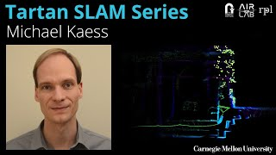
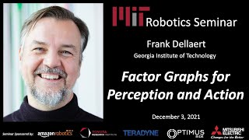
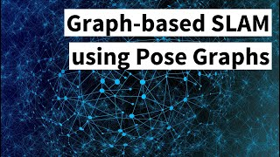
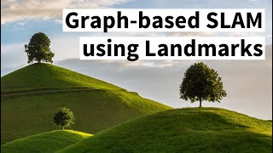


Factor Graphs
Factor Graph 5 Minutes with Cyrill https://youtu.be/uuiaqGLFYa4 | Factor Graphs and Robuts Perception https://youtu.be/JmR2YpkLNt0 | Factor Graphs for Perception and Action https://youtu.be/-yCC7mpgL4w | Graph-based SLAM using Pose Graphs (Cyrill Stachniss) https://youtu.be/uHbRKvD8TWg | Graph-based SLAM with Landmarks (Cyrill Stachniss) https://youtu.be/mZBdPgBtrCM
SLAM Handbook https://github.com/SLAM-Handbook-contributors/slam-handbook-public-release | F. Dellaert, M. Kaess, and T. Barfoot, "Factor Graphs for SLAM," in SLAM Handbook: From Localization and Mapping to Spatial Intelligence, L. Carlone, A. Kim, T. Barfoot, D. Cremers, and F. Dellaert, Eds. Cambridge University Press, 2026.
https://www.cs.cmu.edu/~kaess/pub/Dellaert17fnt.pdf | F. Dellaert, M. Kaess, et al. 2017. “Factor Graphs for Robot Perception”. Foundations and Trends® in Robotics, 6(1-2), 1–139.
https://www.doc.ic.ac.uk/~ajd/Publications/Strasdat-H-2012-PhD-Thesis.pdf | H. Strasdat, “Monocular Exploration”, in Local accuracy and global consistency for efficient visual SLAM, Doctoral dissertation, Department of Computing, Imperial College London, 2012
https://github.com/alejandrofontan/SLAM-Course/
https://github.com/ariarobotics/robotic-mapping/blob/main/lectures/Lec14_backend.pdf

Slide 4
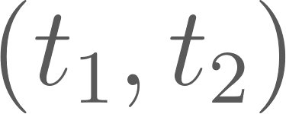
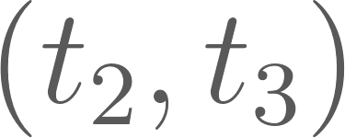
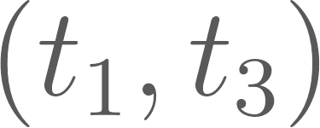






Geometric Consistency Example
Geometric Consistency Example: Suppose we compute odometry estimates between
Estimates can be geometrically inconsistent (always are in practice!)
*Courtesy of Maani Ghaffari, Ryan Eustice, Frank Dellaert, Michael Kaess, Cyrill Stachniss, Pranav Ganti, Luca Carlone

Slide 5

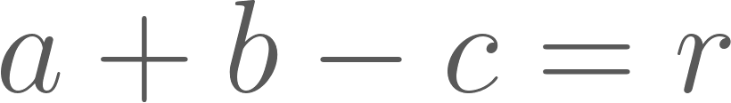
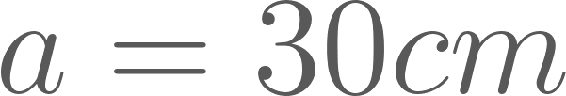
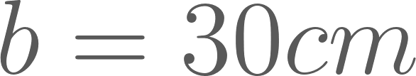
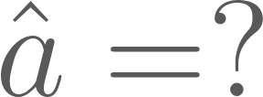
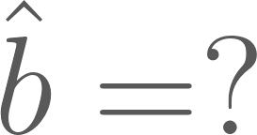
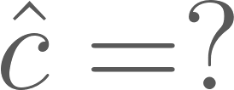
Geometric Consistency Example
Geometric Consistency Example: Suppose we compute odometry estimates between
We can take average of the estimates to obtain consistent results
*Courtesy of Maani Ghaffari, Ryan Eustice, Frank Dellaert, Michael Kaess, Cyrill Stachniss, Pranav Ganti, Luca Carlone

Slide 6
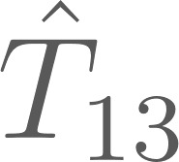
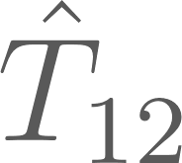
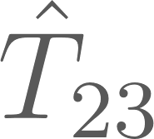

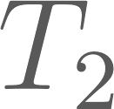
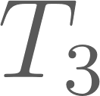
Factor Graph
Factor Graph: Mathematical framework for solving estimation/inference problems and obtain consistency
Problem representation as a graph
Nodes/Vertices: are optimization variable.
Can be of different types (continuous or discrete, poses or landmarks, etc.)
Factors/Edges: represent relationship/constraints between variables (e.g. relative pose estimates, sensor measurements)
*Courtesy of Maani Ghaffari, Ryan Eustice, Frank Dellaert, Michael Kaess, Cyrill Stachniss, Pranav Ganti, Luca Carlone

Slide 7
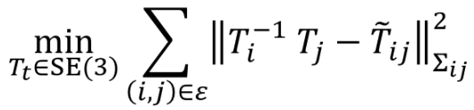
Factor Graph
Pose/factor graph optimization:
*Courtesy of Maani Ghaffari, Ryan Eustice, Frank Dellaert, Michael Kaess, Cyrill Stachniss, Pranav Ganti, Luca Carlone

Slide 8

Factor Graph
Pose/factor graph optimization:
∞
2
1.5
1
0.5
0
*Courtesy of Maani Ghaffari, Ryan Eustice, Frank Dellaert, Michael Kaess, Cyrill Stachniss, Pranav Ganti, Luca Carlone

Slide 9
Factor Graph
Pose/factor graph optimization:
∞ | 30 | 60
2
1.5
1
0.5
0
*Courtesy of Maani Ghaffari, Ryan Eustice, Frank Dellaert, Michael Kaess, Cyrill Stachniss, Pranav Ganti, Luca Carlone

Slide 10
Factor Graph
Pose/factor graph optimization:
∞ | 30 | 60
2
1.5
1
0.5
0 | 25 | 50
*Courtesy of Maani Ghaffari, Ryan Eustice, Frank Dellaert, Michael Kaess, Cyrill Stachniss, Pranav Ganti, Luca Carlone

Slide 11
Factor Graph
Pose/factor graph optimization:
∞ | 30 | 60
2
1.5
1 | 26.67 | 53.33
0.5
0 | 25 | 50
*Courtesy of Maani Ghaffari, Ryan Eustice, Frank Dellaert, Michael Kaess, Cyrill Stachniss, Pranav Ganti, Luca Carlone

Slide 12
Factor Graph
Pose/factor graph optimization:
∞ | 30 | 60
2 | 27.5 | 55
1.5
1 | 26.67 | 53.33
0.5
0 | 25 | 50
*Courtesy of Maani Ghaffari, Ryan Eustice, Frank Dellaert, Michael Kaess, Cyrill Stachniss, Pranav Ganti, Luca Carlone

Slide 13
Factor Graph
Pose/factor graph optimization:
∞ | 30 | 60
2 | 27.5 | 55
1.5 | 27.14 | 54.28
1 | 26.67 | 53.33
0.5 | 26 | 52
0 | 25 | 50
*Courtesy of Maani Ghaffari, Ryan Eustice, Frank Dellaert, Michael Kaess, Cyrill Stachniss, Pranav Ganti, Luca Carlone

Slide 14
What are Factor Graphs?
In this chapter we introduce factor graphs and establish the connection with maximum a posteriori (MAP) inference and least squares for the case of Gaussian priors and Gaussian measurement noise.
We begin by visualizing SLAM problems using factor graphs,
then show how MAP inference leads to least squares optimization.
We discuss methods for solving both linear and nonlinear optimization problem,
and then make the connection between sparsity, factor graphs, and Bayes nets more explicit.
F. Dellaert, M. Kaess, and T. Barfoot, "Factor Graphs for SLAM," in SLAM Handbook: From Localization and Mapping to Spatial Intelligence, L. Carlone, A. Kim, T. Barfoot, D. Cremers, and F. Dellaert, Eds. Cambridge University Press, 2026.

Slide 15
Historical note
A smoothing approach to SLAM involves not just the most current robot location, SLAM but the entire robot trajectory up to the current time.
More generally, one can consider the full SLAM problem, i.e., the problem of optimally estimating the entire set of sensor poses along with the parameters of all features in the environment.
From a computational view, this optimization-based smoothing approach was recognized as beneficial since
(a) in contrast to the filtering-based covariance or information matrices, which both become fully dense over time, the information matrix associated with smoothing is and stays sparse;
(b) in typical mapping scenarios (i.e., not repeatedly traversing a small environment) this matrix is a much more compact representation of the map covariance structure.
F. Dellaert, M. Kaess, and T. Barfoot, "Factor Graphs for SLAM," in SLAM Handbook: From Localization and Mapping to Spatial Intelligence, L. Carlone, A. Kim, T. Barfoot, D. Cremers, and F. Dellaert, Eds. Cambridge University Press, 2026.

Slide 16
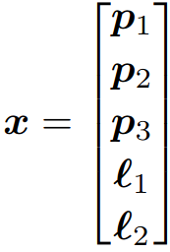
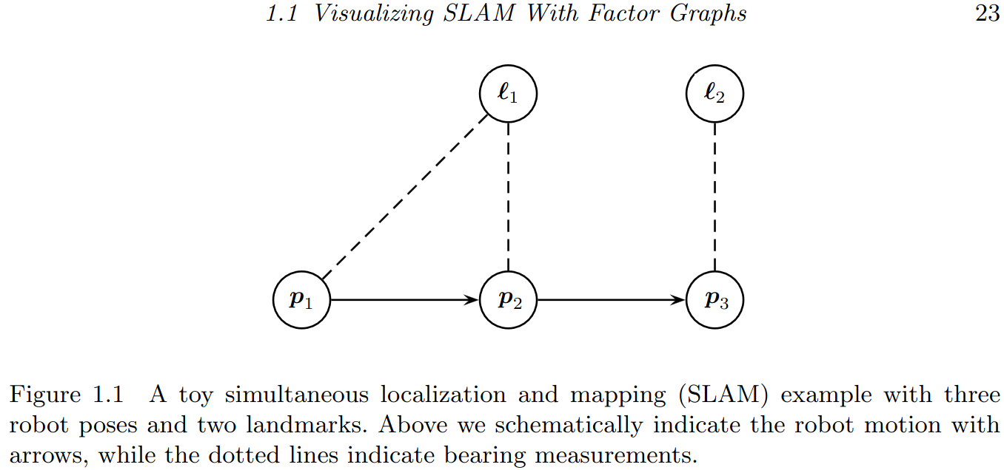


A Toy Example: A simple SLAM Scenario
State
Probability density functions (PDFs)
over the unknown variables
Conditional density or posterior
F. Dellaert, M. Kaess, and T. Barfoot, "Factor Graphs for SLAM," in SLAM Handbook: From Localization and Mapping to Spatial Intelligence, L. Carlone, A. Kim, T. Barfoot, D. Cremers, and F. Dellaert, Eds. Cambridge University Press, 2026.

Slide 17
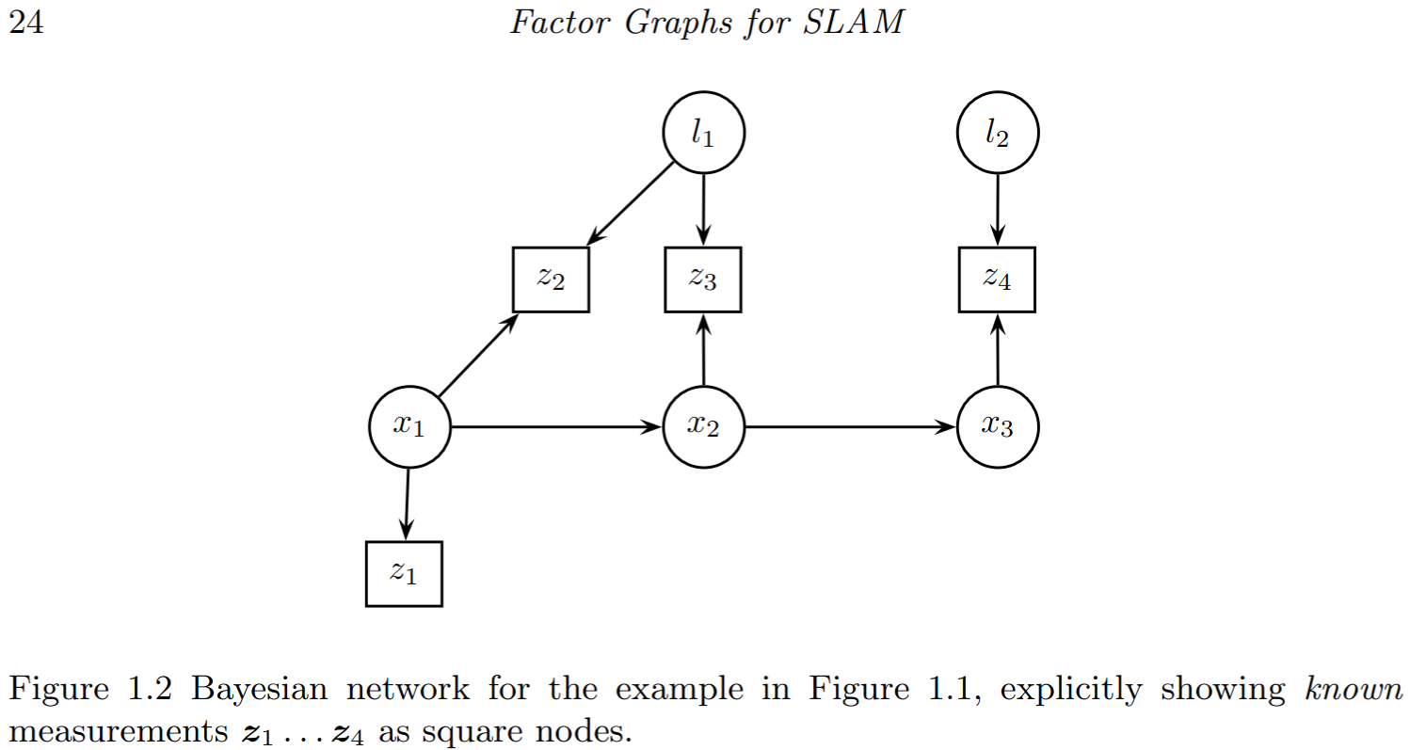
Graphical Models: Bayesian Networks
Bayesian networks consist of variables nodes, each associated with a prior or conditional probability density.
Convention: indicate known quantities as square nodes
Bayesian networks are excellent for modeling
F. Dellaert, M. Kaess, and T. Barfoot, "Factor Graphs for SLAM," in SLAM Handbook: From Localization and Mapping to Spatial Intelligence, L. Carlone, A. Kim, T. Barfoot, D. Cremers, and F. Dellaert, Eds. Cambridge University Press, 2026.

Slide 18
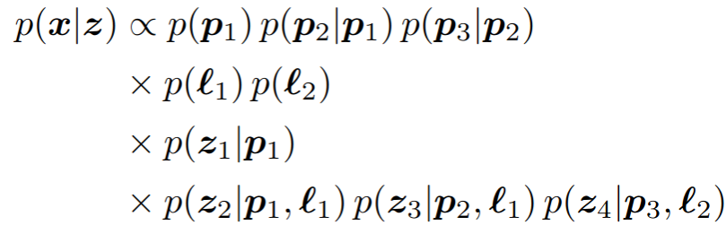
Graphical Models: Bayesian Networks
The posterior can be re-written using Bayes’ law:
Each of the factors represents one piece of information about the unknowns.
Robot motion
Landmark priors
First measurement
Bearing measurements
F. Dellaert, M. Kaess, and T. Barfoot, "Factor Graphs for SLAM," in SLAM Handbook: From Localization and Mapping to Spatial Intelligence, L. Carlone, A. Kim, T. Barfoot, D. Cremers, and F. Dellaert, Eds. Cambridge University Press, 2026.

Slide 19
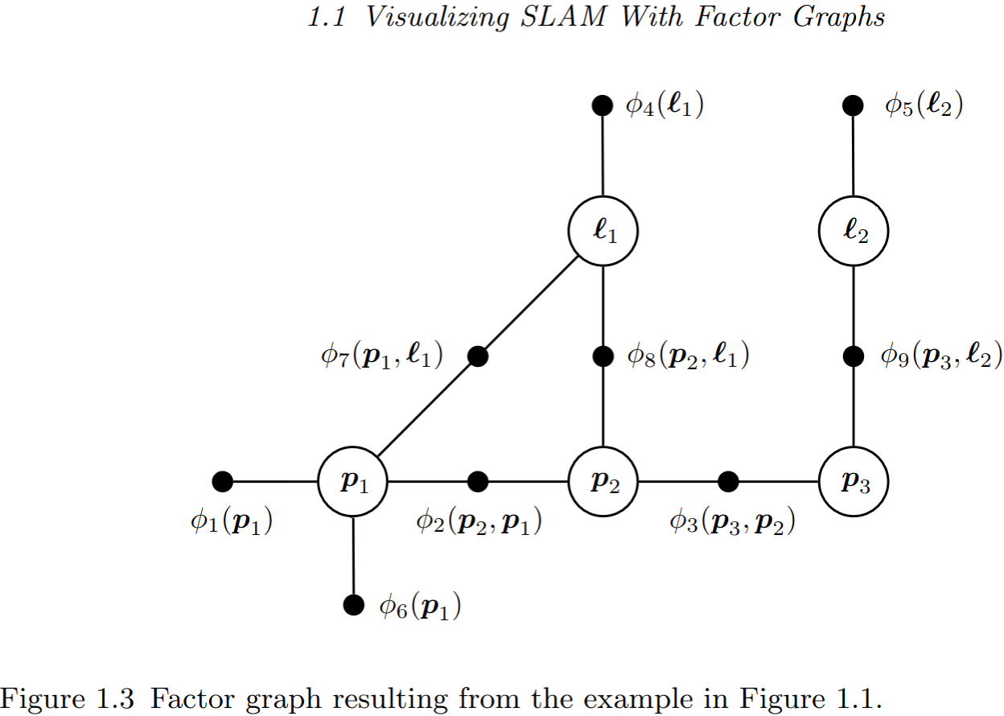
Graphical Models: Factor Graphs
Factor graphs are probabilistic graphical models that allow us to specify any density as a product of factors.
All unknown states x, both poses and landmarks, have a node associated with them.
Measurements are not represented explicitly as they are known.
Small black nodes represent factors, and, importantly, are connected to only those state variables of which they are a function.
F. Dellaert, M. Kaess, and T. Barfoot, "Factor Graphs for SLAM," in SLAM Handbook: From Localization and Mapping to Spatial Intelligence, L. Carlone, A. Kim, T. Barfoot, D. Cremers, and F. Dellaert, Eds. Cambridge University Press, 2026.
Bearing measurements

Slide 20
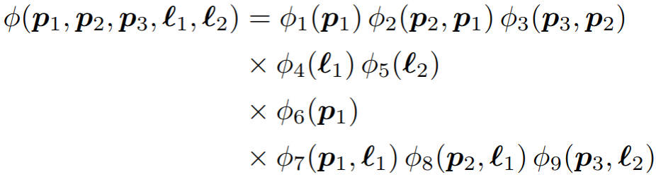
Graphical Models: Factor Graphs
The factor values need only be proportional to the corresponding probability densities: any normalization constants that do not depend on the state variables may be omitted without consequence.
Although the measurement variables are not explicitly shown in the factor graph, those factors are implicitly conditioned on them.
F. Dellaert, M. Kaess, and T. Barfoot, "Factor Graphs for SLAM," in SLAM Handbook: From Localization and Mapping to Spatial Intelligence, L. Carlone, A. Kim, T. Barfoot, D. Cremers, and F. Dellaert, Eds. Cambridge University Press, 2026.
Bearing measurements

Slide 21
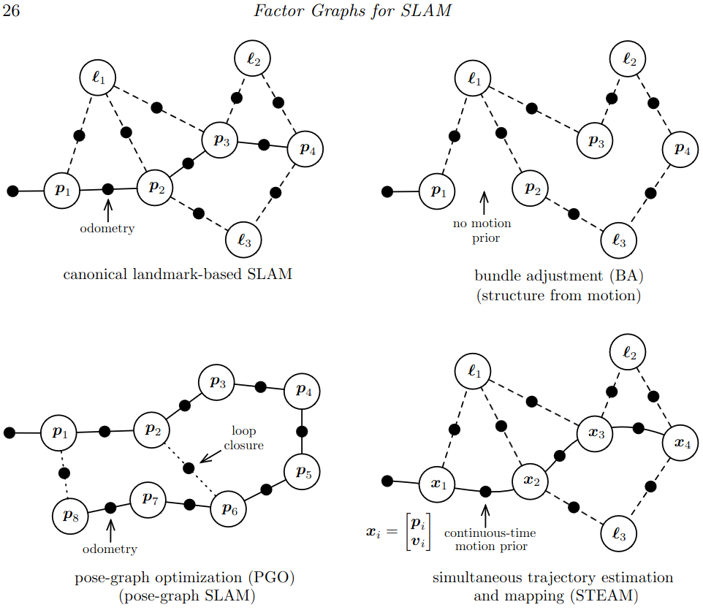
Factor Graphs as a Language
Landmark-based SLAM has both pose and landmark variables; landmarks are measured from poses and there is some motion prior between poses typically based on odometry
Bundle Adjustment (BA) is the same but without the motion prior
Pose-Graph Optimization (PGO) does not have landmark variables but enjoys extra loop closure measurements between poses
Simultaneous Trajectory Estimation and Mapping (STEAM) is similar to landmark-based SLAM, but now poses can be replaced by higher-order states and a smooth continuous-time motion prior is used
F. Dellaert, M. Kaess, and T. Barfoot, "Factor Graphs for SLAM," in SLAM Handbook: From Localization and Mapping to Spatial Intelligence, L. Carlone, A. Kim, T. Barfoot, D. Cremers, and F. Dellaert, Eds. Cambridge University Press, 2026.
Bearing measurements

Slide 22
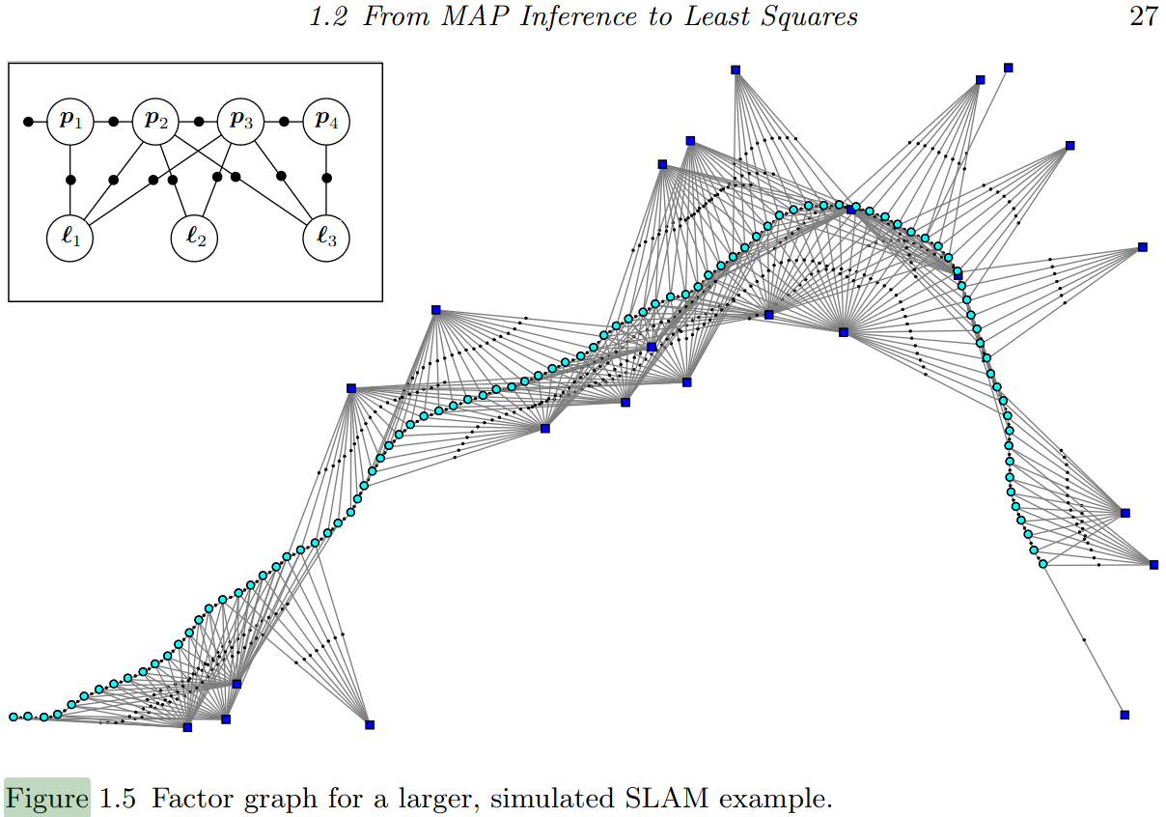
Factor Graphs as a Language
Examining the factor graph reveals a great deal of structure by which we can gain insight into a particular instance of the SLAM problem:
First, there are landmarks with a great deal of measurements, which we expect to be pinned down very well.
Others have only a tenuous connection to the graph, and hence we expect them to be less well determined. For example, the lone landmark near the bottom right has only a single measurement associated with it
F. Dellaert, M. Kaess, and T. Barfoot, "Factor Graphs for SLAM," in SLAM Handbook: From Localization and Mapping to Spatial Intelligence, L. Carlone, A. Kim, T. Barfoot, D. Cremers, and F. Dellaert, Eds. Cambridge University Press, 2026.
Bearing measurements

Slide 23
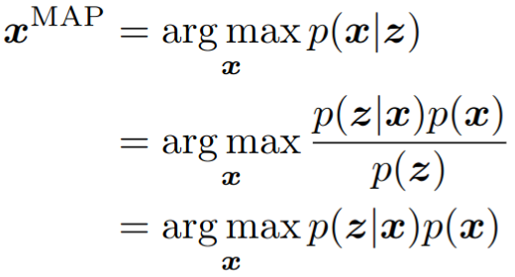
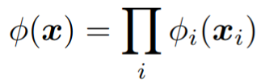
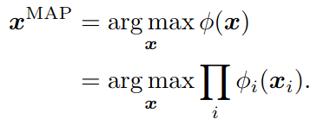
Factor Graphs for MAP Inference
maximum a posteriori (MAP) estimate
A factor graph F defines the factorization of a global function:
For an arbitrary factor graph, MAP inference comes down to maximizing the product of all factor-graph potentials:
posterior density given
the measurements
Bayes’ Law
F. Dellaert, M. Kaess, and T. Barfoot, "Factor Graphs for SLAM," in SLAM Handbook: From Localization and Mapping to Spatial Intelligence, L. Carlone, A. Kim, T. Barfoot, D. Cremers, and F. Dellaert, Eds. Cambridge University Press, 2026.

Slide 24
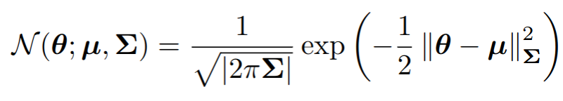

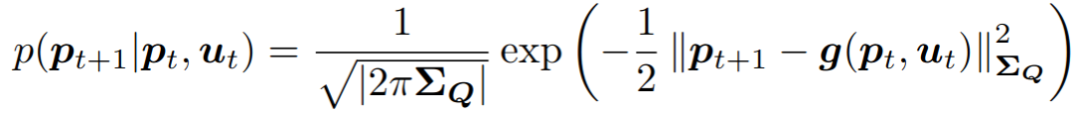

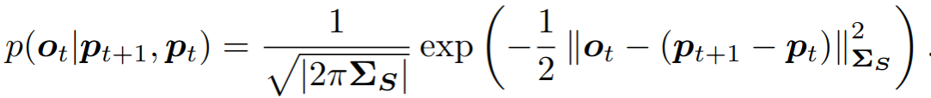

Factor Graphs for MAP Inference
multivariate Gaussian density
squared Mahalanobis distance
bearing measurement
motion model
conditional density of the measurement
conditional density of the prior
conditional density of the prior (wo control inputs)
F. Dellaert, M. Kaess, and T. Barfoot, "Factor Graphs for SLAM," in SLAM Handbook: From Localization and Mapping to Spatial Intelligence, L. Carlone, A. Kim, T. Barfoot, D. Cremers, and F. Dellaert, Eds. Cambridge University Press, 2026.

Slide 25
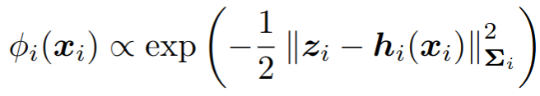
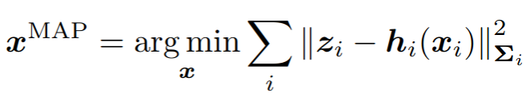
Factor Graphs for MAP Inference
maximum a posteriori (MAP) estimate
A factor graph F defines the factorization of a global function:
For an arbitrary factor graph, MAP inference comes down to maximizing the product of all factor-graph potentials:
conditional density of the measurement
Let us assume that all factors are proportional to a multivariate Gaussian, i.e.,
Taking the negative log and dropping the factor 1/2 allows us
to instead minimize a sum of nonlinear least squares terms:
posterior density given
the measurements
Bayes’ Law
F. Dellaert, M. Kaess, and T. Barfoot, "Factor Graphs for SLAM," in SLAM Handbook: From Localization and Mapping to Spatial Intelligence, L. Carlone, A. Kim, T. Barfoot, D. Cremers, and F. Dellaert, Eds. Cambridge University Press, 2026.

Slide 26
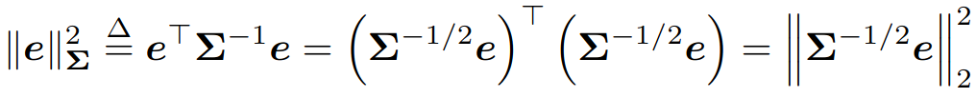
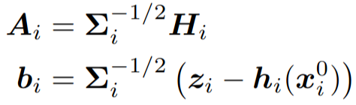
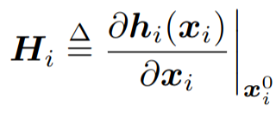
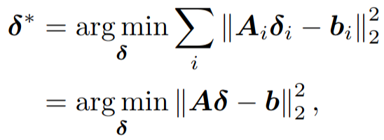
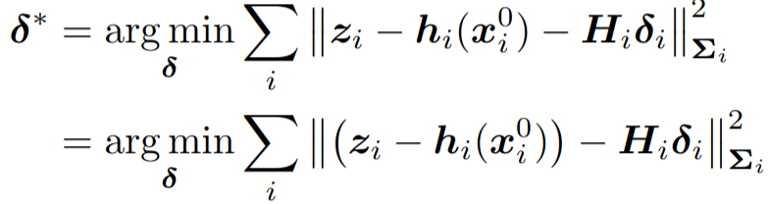

Solving Linear Least Squares
nonlinear least squares
Taylor expansion
linear least squares
rewrite the square Mahalanobis norm
whitening
linear least squares
normal equations
F. Dellaert, M. Kaess, and T. Barfoot, "Factor Graphs for SLAM," in SLAM Handbook: From Localization and Mapping to Spatial Intelligence, L. Carlone, A. Kim, T. Barfoot, D. Cremers, and F. Dellaert, Eds. Cambridge University Press, 2026.

Slide 27
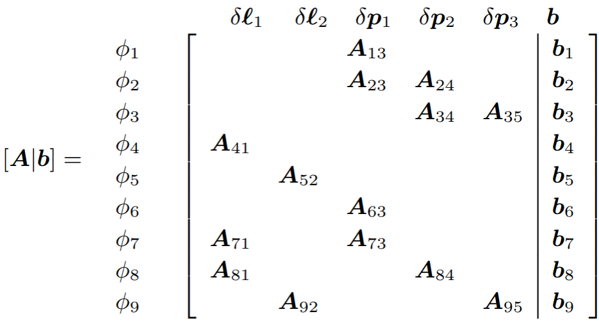
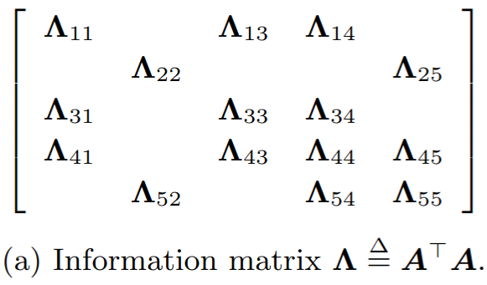
Factor Graphs and Sparsity
F. Dellaert, M. Kaess, and T. Barfoot, "Factor Graphs for SLAM," in SLAM Handbook: From Localization and Mapping to Spatial Intelligence, L. Carlone, A. Kim, T. Barfoot, D. Cremers, and F. Dellaert, Eds. Cambridge University Press, 2026.
Bearing measurements

Slide 28
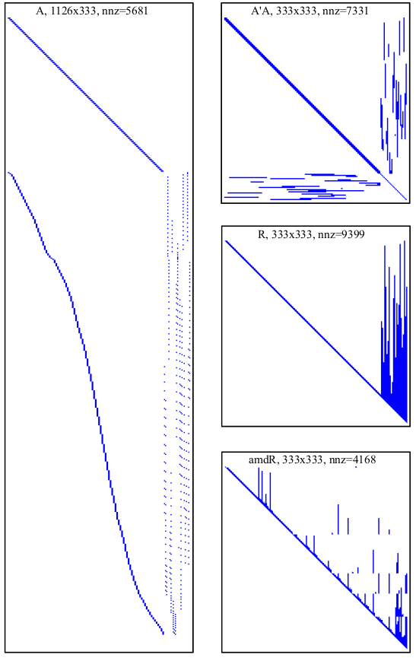
Factor Graphs and Sparsity
F. Dellaert, M. Kaess, and T. Barfoot, "Factor Graphs for SLAM," in SLAM Handbook: From Localization and Mapping to Spatial Intelligence, L. Carlone, A. Kim, T. Barfoot, D. Cremers, and F. Dellaert, Eds. Cambridge University Press, 2026.
Bearing measurements

Slide 29
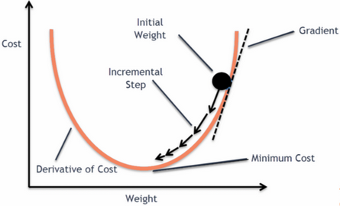
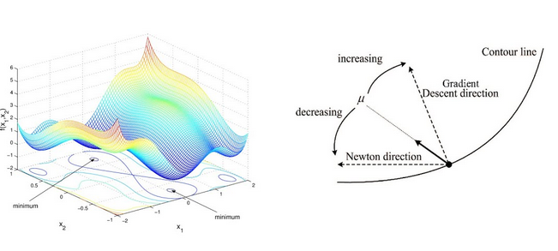
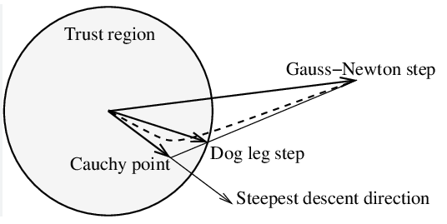
Nonlinear Optimization
Steepest Descent Gauss Newton Levenberg-Marquardt
Dogleg Minimization
F. Dellaert, M. Kaess, and T. Barfoot, "Factor Graphs for SLAM," in SLAM Handbook: From Localization and Mapping to Spatial Intelligence, L. Carlone, A. Kim, T. Barfoot, D. Cremers, and F. Dellaert, Eds. Cambridge University Press, 2026.

Slide 30
Solvers
GTSAM https://gtsam.org/
G2o https://openslam-org.github.io/g2o.html
Ceres https://github.com/ceres-solver/ceres-solver
F. Dellaert, M. Kaess, and T. Barfoot, "Factor Graphs for SLAM," in SLAM Handbook: From Localization and Mapping to Spatial Intelligence, L. Carlone, A. Kim, T. Barfoot, D. Cremers, and F. Dellaert, Eds. Cambridge University Press, 2026.

Slide 31

The SLAM problem
*Courtesy of Maani Ghaffari, Ryan Eustice, Frank Dellaert, Michael Kaess, Cyrill Stachniss, Pranav Ganti, Luca Carlone

Slide 32


The SLAM problem (t = 0)
Landmark factor
Landmark 1

Slide 33
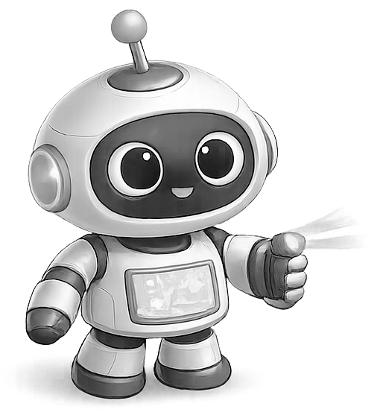

The SLAM problem (t = 1)
Odometry factor
Landmark factor
Landmark 1

Slide 34



The SLAM problem (t = 1)
Odometry factor
Landmark factor
Landmark 1
Landmark 2

Slide 35
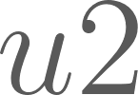
The SLAM problem (t = …)
Odometry factor
Landmark factor
Landmark 1
Landmark 2

Slide 36

The SLAM problem (t = n-1)
Odometry factor
Landmark factor
Landmark 1
Landmark 2

Slide 37


The SLAM problem (t = n-1)
Odometry factor
Landmark factor
Landmark 1
Landmark 2

Slide 38

The SLAM problem (t = n-1)
Loop closing factor
Odometry factor
Landmark factor
Landmark 1
Landmark 2

Slide 39


The SLAM problem (t = n)
Loop closing factor
Odometry factor
Landmark factor
Landmark 1
Landmark 2

Slide 40
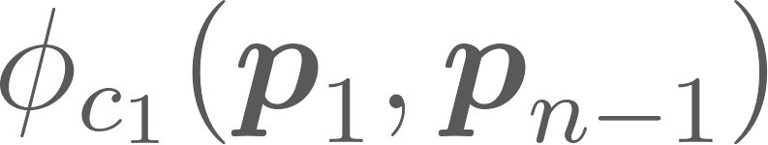
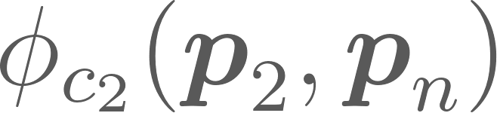
















The SLAM problem (t = n)
Loop closing factor
Odometry factor
Landmark factor
Landmark 1
Landmark 2

Slide 41




Pose Graph Optimization: Example
*Courtesy of Maani Ghaffari, Ryan Eustice, Frank Dellaert, Michael Kaess, Cyrill Stachniss, Pranav Ganti, Luca Carlone

Slide 42


Pose Graph Optimization: Example
*Courtesy of Maani Ghaffari, Ryan Eustice, Frank Dellaert, Michael Kaess, Cyrill Stachniss, Pranav Ganti, Luca Carlone

Slide 43

Pose Graph Optimization: Example
https://youtu.be/KYvOqUB_odg
*Courtesy of Maani Ghaffari, Ryan Eustice, Frank Dellaert, Michael Kaess, Cyrill Stachniss, Pranav Ganti, Luca Carlone

Slide 44
Landmark-based SLAM
Loop closing factor
Odometry factor
Landmark factor
Landmark 1
Landmark 2

Slide 45


Landmark-based SLAM
H. Strasdat, “Monocular Exploration”, in Local accuracy and global consistency for efficient visual SLAM, Doctoral dissertation, Department of Computing, Imperial College London, 2012

Slide 46

Robustness to Outliers: Robust loss functions
F. Dellaert, M. Kaess, and T. Barfoot, "Factor Graphs for SLAM," in SLAM Handbook: From Localization and Mapping to Spatial Intelligence, L. Carlone, A. Kim, T. Barfoot, D. Cremers, and F. Dellaert, Eds. Cambridge University Press, 2026.

Slide 47
SLAM Course
08 - Factor Graphs
Dr Alejandro Fontán Villacampa
April 2026

